Slide 1
Object Oriented Programming
Week 5
Email: abeer.gauher@nu.edu.pk
Office: CS BASEMENT 2, Office number 23

Slide 2
Contents
Static variables
Static functions
Final variable

Slide 3
What is static
The static keyword is used when a member variable of a class has to be shared between all the instances of the class.
All static variables and methods belong to the class and not to any instance of the class

Slide 4
When can we access static variable
When a class is loaded by the virtual machine all the static variables and methods are available for use.
Hence we don’t need to create any instance of the class for using the static variables or methods.
Variables which don’t have static keyword in the definition are implicitly non static.

Slide 5
Example
Class staticDemo{
public static int a = 100; // All instances of staticDemo have this variable as a common variable
public int b =2 ;
public static showA(){
System.out.println(“A is “+a);
}}
Class execClass{
public static void main(String args[]){
staticDemo.a = 35; // when we use the class name, the class is loaded, direct access to a without any instance
staticDemo.b=22; // ERROR this is not valid for non static variable
staticDemo demo = new staticDemo();
demo.b = 200; // valid to set a value for a non static variable after creating an instance.
staticDemo.showA(); //prints 35
}}

Slide 6
Static and Non-static
We can access static variables without creating an instance of the class
As they are already available at class loading time, we can use them in any of our non static methods.
We cannot use non static methods and variables without creating an instance of the class as they are bound to the instance of the class.
They are initialized by the constructor when we create the object using new operator.

Slide 7
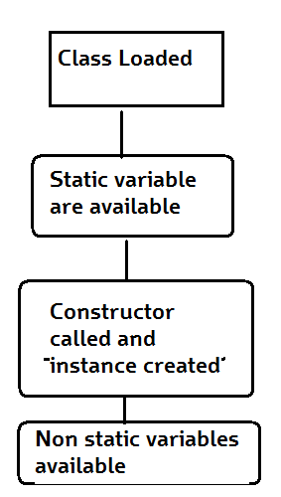
How it works
Basic Steps of how objects are created
Class is loaded by JVM
Static variable and methods are loaded and initialized and available for use
Constructor is called to instantiate the non static variables
Non static variables and methods are now available
As all the non static variable are available only after the constructor is called, there is a restriction on using non static variable in static methods.

Slide 8
Static Variables, Constants, and Methods
Static variables are shared by all the instances of the class.
Static methods are not tied to a specific object. Because of this, a static method cannot access instance members of the class
Static constants are final variables shared by all the instances of the class.
A non-static (or instance) variable is connected to a specific instance

Slide 9
Static Variables, Constants, and Methods
Static variables store values for the variables in a common memory location. Because of this common location, if one object changes the value of a static variable, all objects of the same class are affected.
Java supports static methods as well as static variables. Static methods can be called without creating an instance of the class.

Slide 10
Static Variables, Constants, and Methods, cont.
To declare static variables, constants, and methods, use the static modifier. For example, the constant PI in the Math class is defined as
final static double PI=3.14159265358979323846
Let’s modify the Circle class by adding a static variable numberOfObjects to count the number of circle objects created. When the first object of this class is created, numberOfObjects is 1. When the second object is created, numberOfObjects becomes 2.

Slide 11
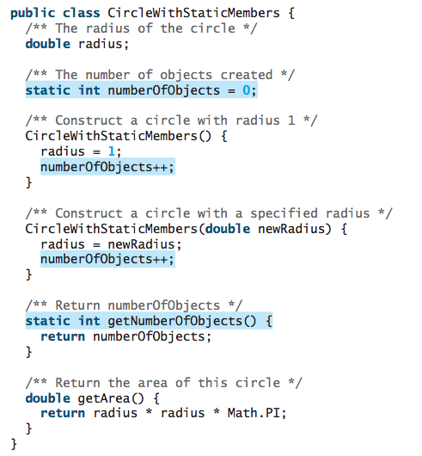

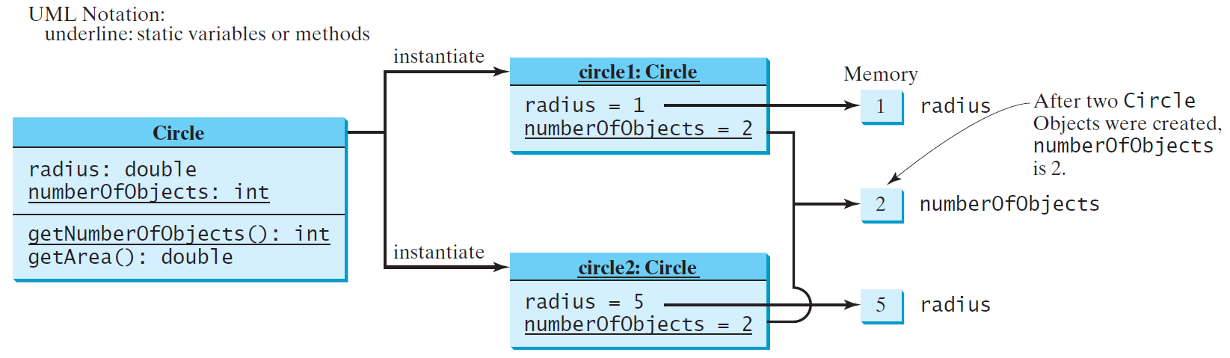
Static Variables, Constants, and Methods, cont.

Slide 12
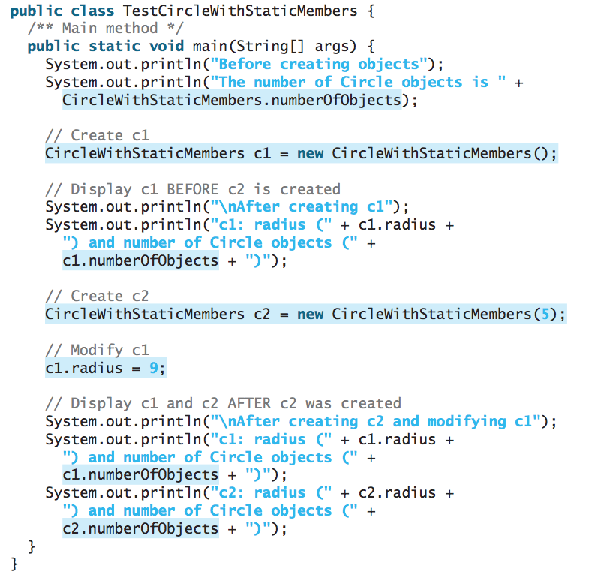
TestCircleWithStaticMembers.java
Static variables and methods can be accessed without creating objects. Line 6 displays the number of objects, which is 0, since no objects have been created.

Slide 13
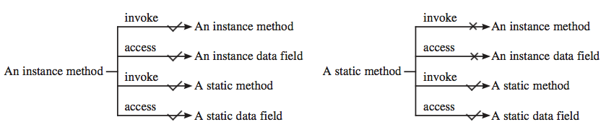
Static and Instance Methods
An instance method can invoke an instance or static method and access an instance or static data field. A static method can invoke a static method and access a static data field. However, a static method cannot invoke an instance method or access an instance data field, since static methods and static data fields don’t belong to a particular object.

Slide 14
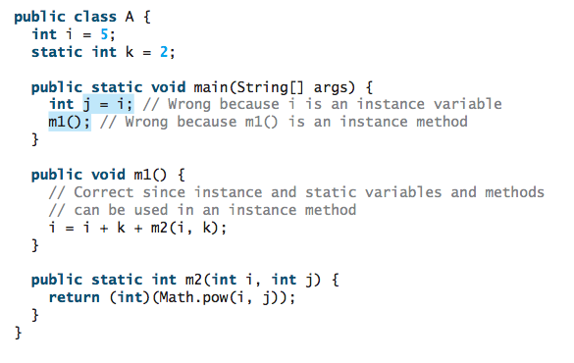
Examples

Slide 15
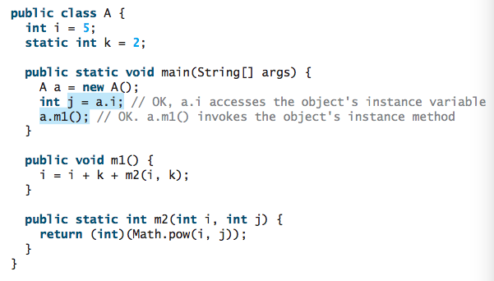
Examples

Slide 16
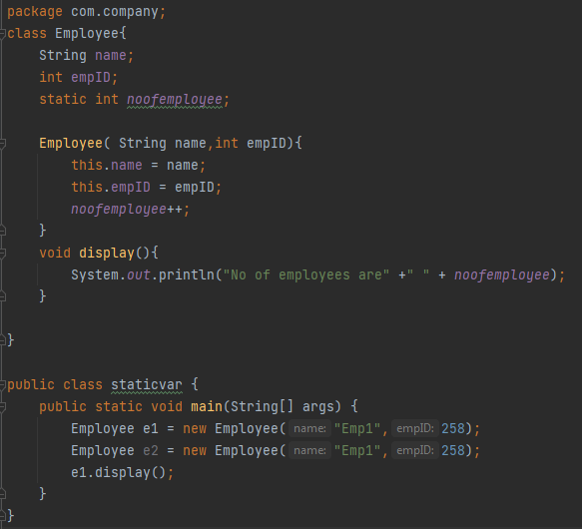

Examples (Static Var)
Created a static variable noofemployee.
Incremented it by +1.
Created 2 objects.
Total no of employees are 2

Slide 17
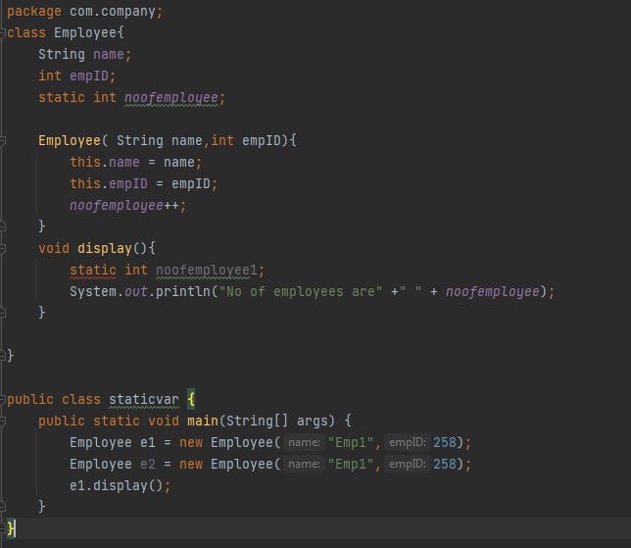
Examples (Static Var)
The concept of static variable is that it does not belong to a specific instance of a class, but to the whole class. When you are declaring a variable inside a method, it becomes a local variable, they do not have any existence outside of that method.
If we take a more technical look at it, JVM allocates memory to static variables when the class is loaded, not when the object is created. When you declare a static variable inside a method, it comes under the method’s scope, and JVM is unable to allocate memory for it.

Slide 18
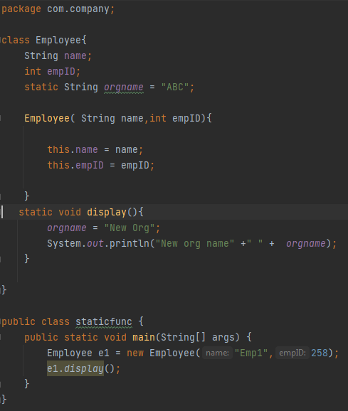

Examples (Static Methods)
Static methods can only access static variables.

Slide 19
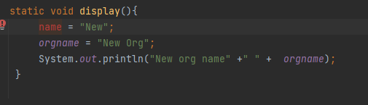

Examples (Static Methods)
Static methods can only access static variables.
Accessing a non static variable gives an error.

Slide 20
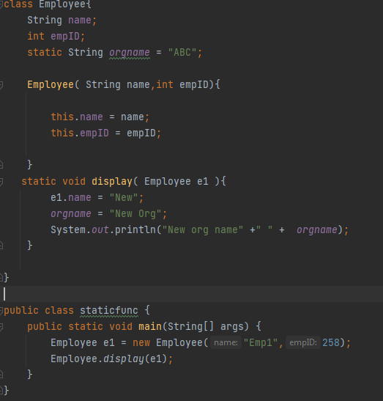

Examples (Static Methods)
Static methods can access non static variable only by creating an object of the class. Employee object can be passed as a parameter or you can create an object inside the function.

Slide 21
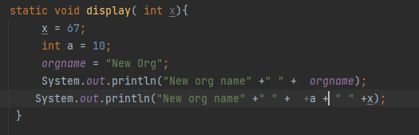
Examples (Static Methods)
You can create a non static variable in the class or pass a non static variable as a parameter.

Slide 22
Final keyword
In Java, we can use final keyword with variables, methods, and classes.
When the final keyword is used with a variable of primitive data types such as int, float, etc), the value of the variable cannot be changed.

Slide 23
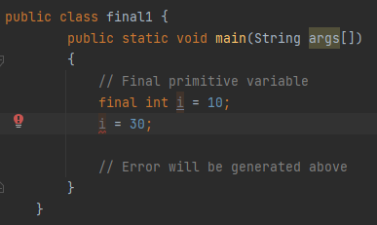

Final keyword

Slide 24
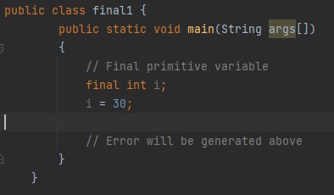
Final keyword
final local variable is not required to be initialized during declaration.

Slide 25
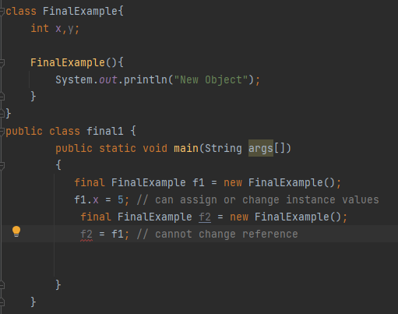

Final keyword
final object variable reference cannot be changed.

Slide 26

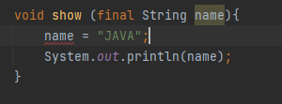
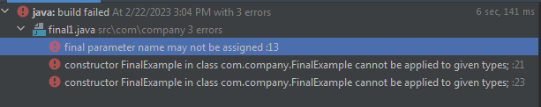
Final keyword
final variable can be passed as a parameter in the function.
Final parameter cannot be assigned again inside the function.

Slide 27

Final keyword
Final instance variable can be set inside the constructor.

Slide 28
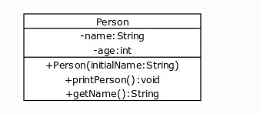
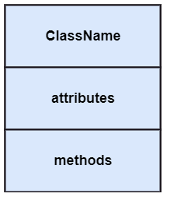
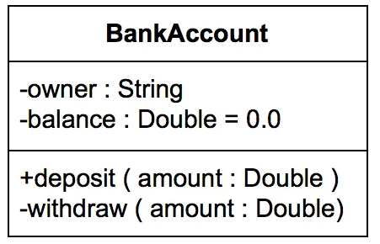
Class Diagram Example

Slide 29
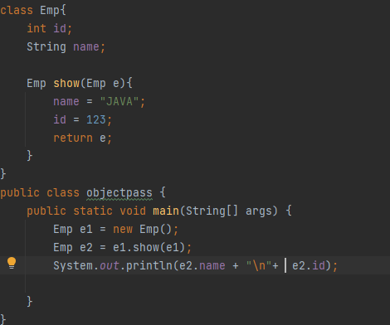

Simple Object Passing and return

